Slide 1
BLM267
Chapter 10: Efficient Binary Trees
Data Structures Using C, Second Edition

Slide 2
Binary Search Trees
Operations on Binary Search Trees
Threaded Binary Trees

Slide 3
Binary Search Trees
We have already discussed binary trees in the previous chapter.
A binary search tree, also known as an ordered binary tree, is a variant of binary trees in which the nodes are arranged in an order.
In a binary search tree, all the nodes in the left sub-tree have a value less than that of the root node.
Correspondingly, all the nodes in the right sub-tree have a value either equal to or greater than the root node.
The same rule is applicable to every sub-tree in the tree.
(Note that a binary search tree may or may not contain duplicate values, depending on its implementation.)

Slide 4
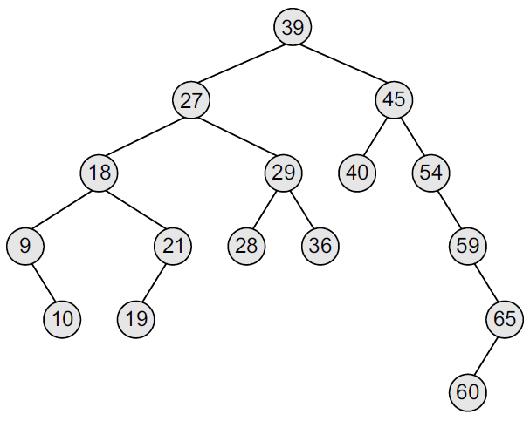
Binary Search Trees
The root node is 39. The left sub-tree of the root node consists of nodes 9, 10, 18, 19, 21, 27, 28, 29, and 36.
All these nodes have smaller values than the root node.
The right sub-tree of the root node consists of nodes 40, 45, 54, 59, 60, and 65.
Recursively, each of the sub-trees also obeys the binary search tree constraint.
For example, in the left sub-tree of the root node, 27 is the root and all elements in its left sub-tree (9, 10, 18, 19, 21) are smaller than 27, while all nodes in its right sub-tree (28, 29, and 36) are greater than the root node’s value.

Slide 5
Binary Search Trees
Since the nodes in a binary search tree are ordered, the time needed to search an element in the tree is greatly reduced.
Whenever we search for an element, we do not need to traverse the entire tree. At every node, we get a hint regarding which sub-tree to search in.
For example, in the given tree, if we have to search for 29, then we know that we have to scan only the left sub-tree. If the value is present in the tree, it will only be in the left sub-tree, as 29 is smaller than 39 (the root node’s value). The left sub-tree has a root node with the value 27. Since 29 is greater than 27, we will move to the right sub-tree, where we will find the element.
Due to its efficiency in searching elements, binary search trees are widely used in dictionary problems where the code always inserts and searches the elements that are indexed by some key value.

Slide 6
Binary Search Trees
Binary search trees also speed up the insertion and deletion operations.
The tree has a speed advantage when the data in the structure changes rapidly.
Binary search trees are considered to be efficient data structures especially when compared with sorted linear arrays and linked lists.
In binary search tree, the average running time of a search operation is O(log₂n), as at every step, we eliminate half of the sub-tree from the search process.
In a sorted array, searching can be done in O(log₂n) time, but insertions and deletions are quite expensive.
In contrast, inserting and deleting elements in a linked list is easier, but searching for an element is done in O(n) time.

Slide 7
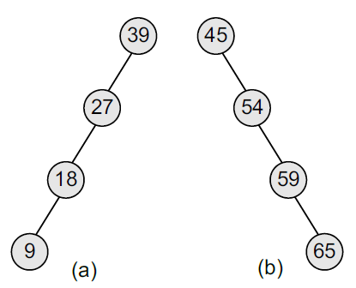
Binary Search Trees
However, in the worst case, a binary search tree will take O(n) time to search for an element.
The worst case would occur when the tree is a linear chain of nodes as given in Figure.
To summarize, a binary search tree is a binary tree with the following properties:
The left sub-tree of a node N contains values that are less than N’s value.
The right sub-tree of a node N contains values that are greater than N’s value.
Both the left and the right binary trees also satisfy these properties and, thus, are binary search trees.

Slide 8
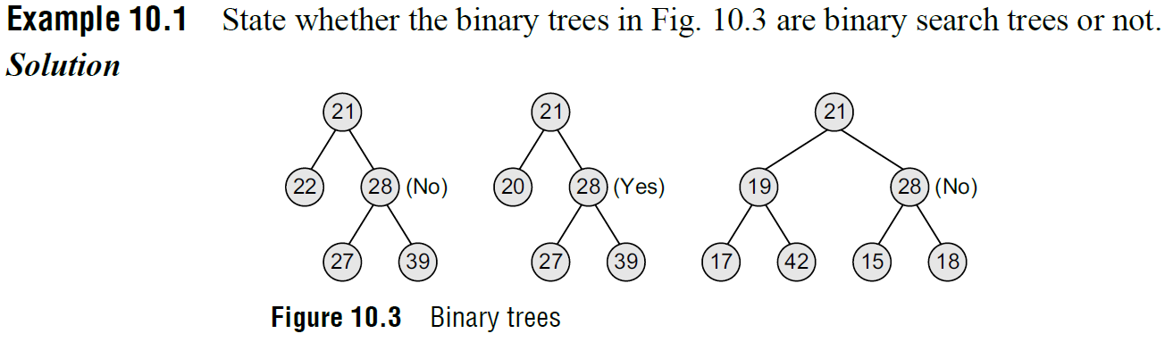
Binary Search Trees

Slide 9
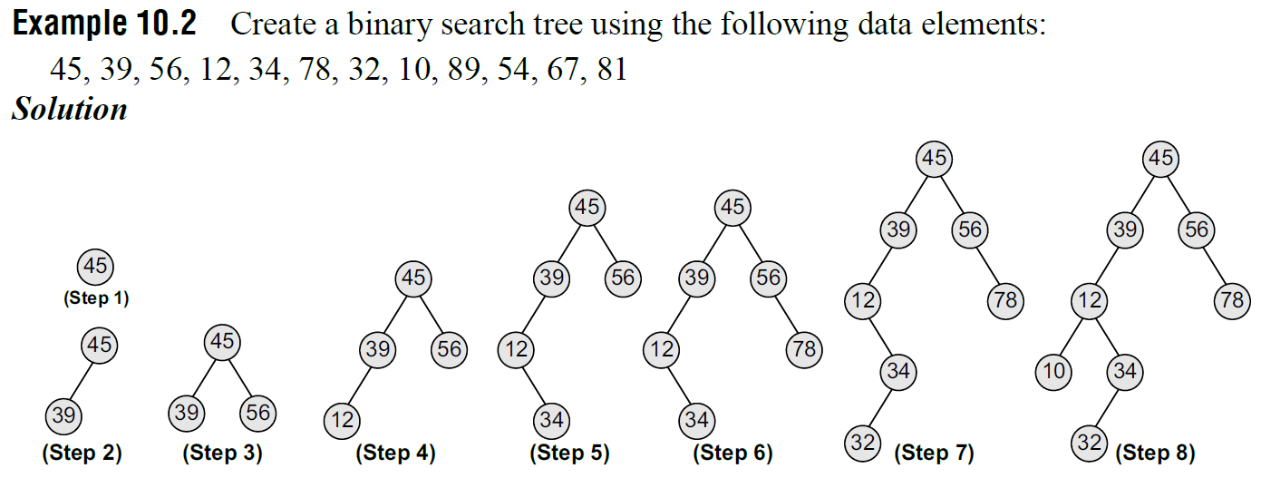
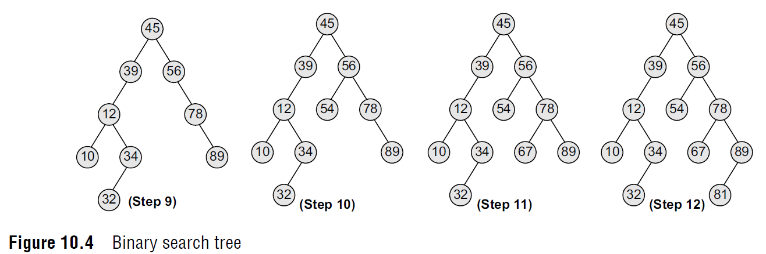
Binary Search Trees

Slide 10
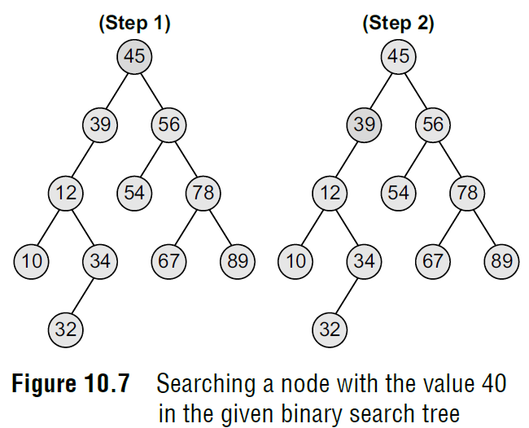
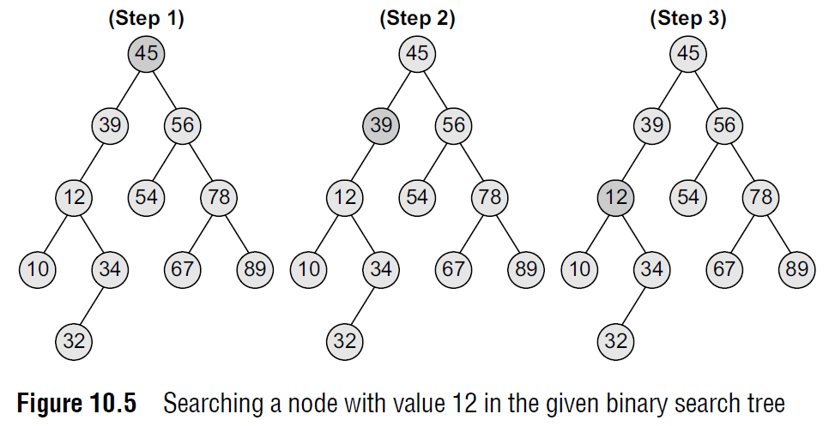
Searching for a Node in a Binary Search Tree
The search function is used to find whether a given value is present in the tree or not.
The searching process begins at the root node. The function first checks if the binary search tree is empty. If it is empty, then the value we are searching for is not present in the tree.
So, the search algorithm terminates by displaying an appropriate message.
However, if there are nodes in the tree, then the search function checks to see if the key value of the current node is equal to the value to be searched.
If not, it checks if the value to be searched for is less than the value of the current node, in which case it should be recursively called on the left child node.
In case the value is greater than the value of the current node, it should be recursively called on the right child node.

Slide 11
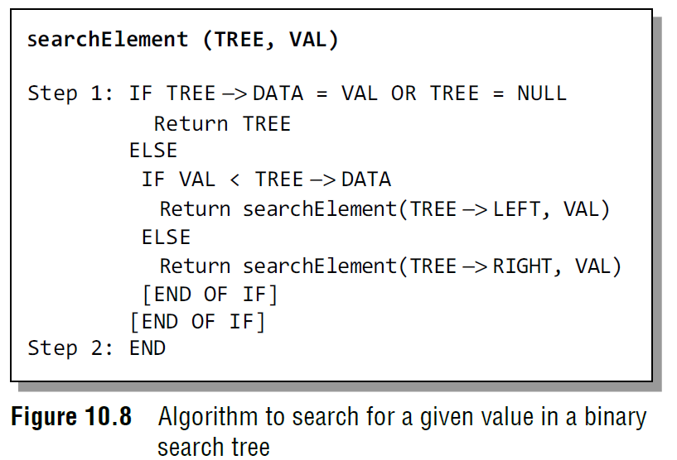
Searching for a Node in a Binary Search Tree
In Step 1, we check if the value stored at the current node of TREE is equal to VAL or if the current node is NULL, then we return the current node of TREE.
Otherwise, if the value stored at the current node is less than VAL, then the algorithm is recursively called on its right sub-tree, else the algorithm is called on its left sub-tree.

Slide 12
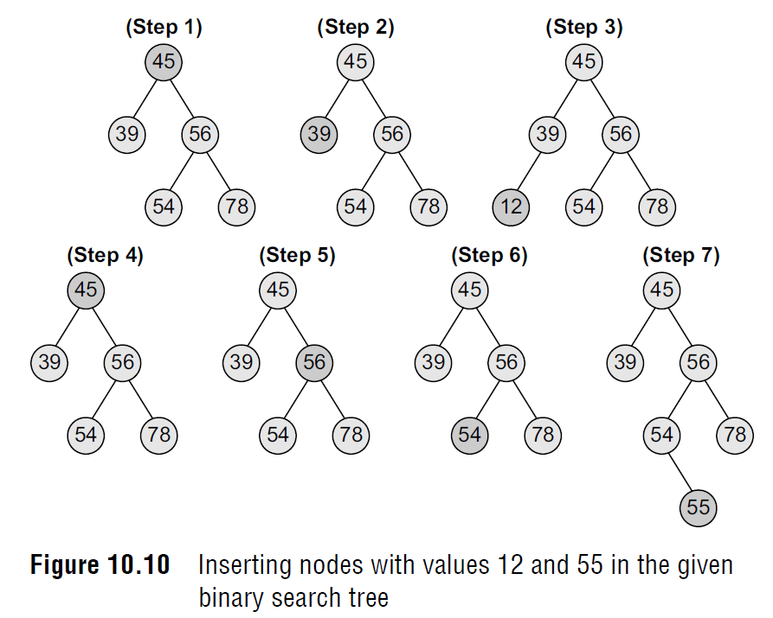
Inserting a New Node in a Binary Search Tree
The insert function is used to add a new node with a given value at the correct position in the binary search tree.
Adding the node at the correct position means that the new node should not violate the properties of the binary search tree.
The initial code for the insert function is similar to the search function. This is because we first find the correct position where the insertion has to be done and then add the node at that position.

Slide 13
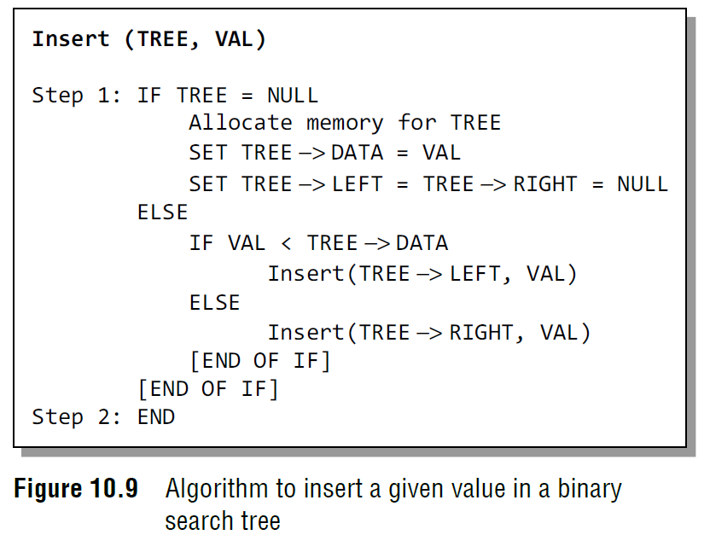
Inserting a New Node in a Binary Search Tree
In Step 1 of the algorithm, the insert function checks if the current node of TREE is NULL. If it is NULL, the algorithm simply adds the node, else it looks at the current node’s value and then recurs down the left or right sub-tree.
If the current node’s value is less than that of the new node, then the right sub-tree is traversed, else the left sub-tree is traversed.
The insert function continues moving down the levels of a binary tree until it reaches a leaf node. The new node is added by following the rules of the binary search trees.
That is, if the new node’s value is greater than that of the parent node, the new node is inserted in the right sub-tree, else it is inserted in the left sub-tree.
The insert function requires time proportional to the height of the tree in the worst case.
It takes O(log n) time to execute in the average case and O(n) time in the worst case.

Slide 14
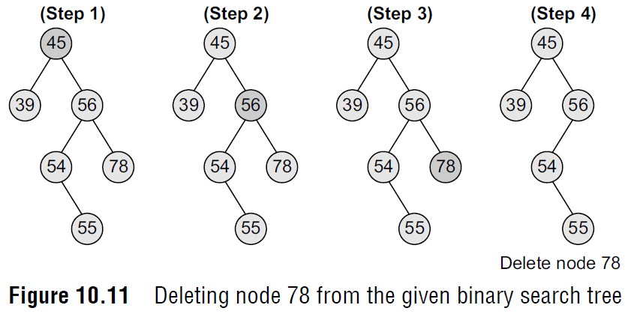
Deleting a Node from a Binary Search Tree
Case 1: Deleting a Node that has No Children
Look at the binary search tree given in Figure.
If we have to delete node 78, we can simply remove this node without any issue.
This is the simplest case of deletion.

Slide 15
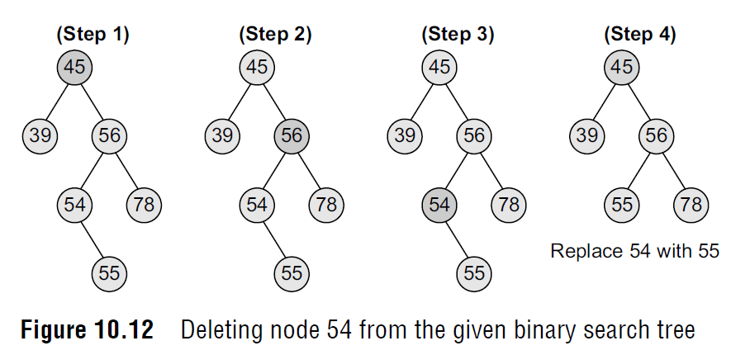
Deleting a Node from a Binary Search Tree
Case 2: Deleting a Node with One Child
To handle this case, the node’s child is set as the child of the node’s parent. In other words, replace the node with its child.
Now, if the node is the left child of its parent, the node’s child becomes the left child of the node’s parent.
Correspondingly, if the node is the right child of its parent, the node’s child becomes the right child of the node’s parent.
Look at the binary search tree shown in Figure and see how deletion of node 54 is handled.

Slide 16
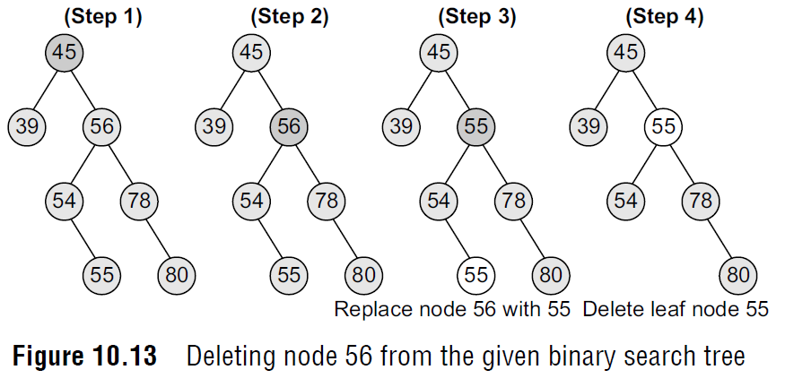
Deleting a Node from a Binary Search Tree
Case 3: Deleting a Node with Two Children
To handle this case, replace the node’s value with its in-order predecessor (largest value in the left sub-tree) or in-order successor (smallest value in the right sub-tree).
The in-order predecessor or the successor can then be deleted using any of the above cases.
Look at the binary search tree given in Fig. 10.13 and see how deletion of node with value 56 is handled.

Slide 17
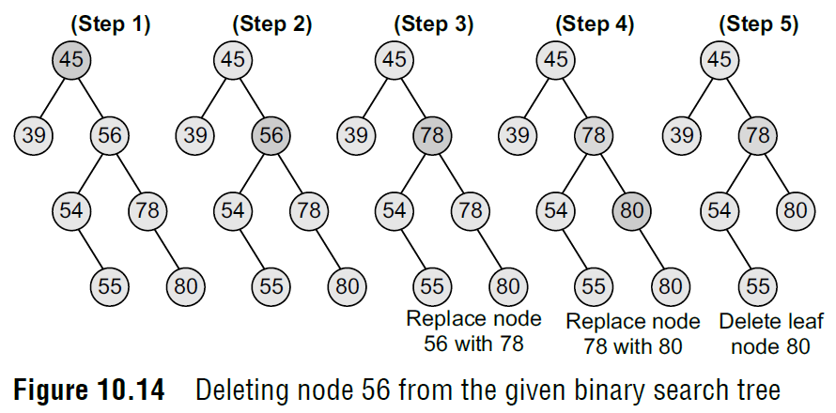
Deletiang a Node from a Binary Search Tree
Case 3: Deleting a Node with Two Children
To handle this case, replace the node’s value with its in-order predecessor (largest value in the left sub-tree) or in-order successor (smallest value in the right sub-tree).
The in-order predecessor or the successor can then be deleted using any of the above cases.
This deletion could also be handled by replacing node 56 with its in-order successor, as shown in Fig. 10.14.

Slide 18
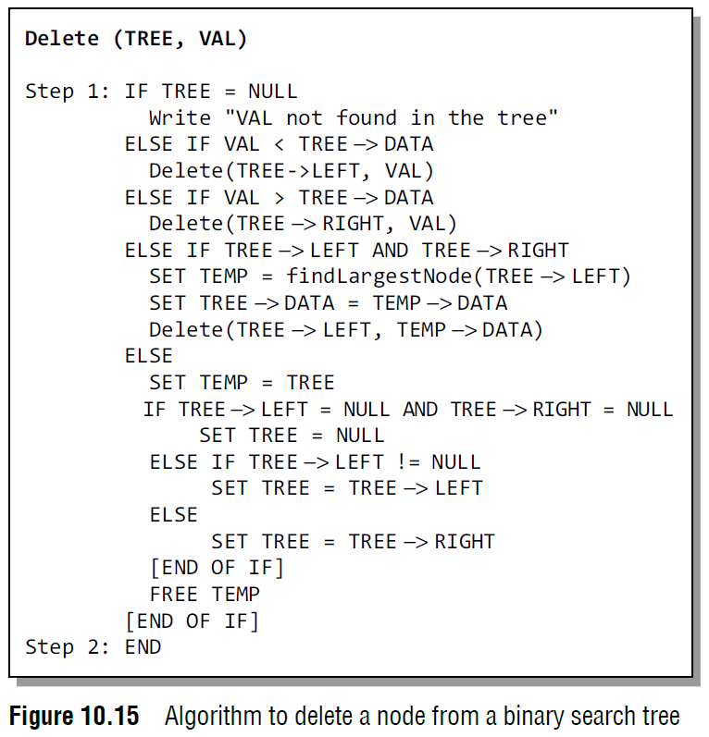
Deleting a Node from a Binary Search Tree

Slide 19
Deleting a Node from a Binary Search Tree
In Step 1 of the algorithm, we first check if TREE=NULL, because if it is true, then the node to be deleted is not present in the tree.
However, if that is not the case, then we check if the value to be deleted is less than the current node’s data. In case the value is less, we call the algorithm recursively on the node’s left sub-tree, otherwise the algorithm is called recursively on the node’s right sub-tree.
Note that if we have found the node whose value is equal to VAL, then we check which case of deletion it is. If the node to be deleted has both left and right children, then we find the in-order predecessor of the node by calling findLargestNode(TREE -> LEFT) and replace the current node’s value with that of its in-order predecessor.
Then, we call Delete(TREE -> LEFT, TEMP -> DATA) to delete the initial node of the in-order predecessor. Thus, we reduce the case 3 of deletion into either case 1 or case 2 of deletion.
If the node to be deleted does not have any child, then we simply set the node to NULL. Last but not the least, if the node to be deleted has either a left or a right child but not both, then the current node is replaced by its child node and the initial child node is deleted from the tree.
The delete function requires time proportional to the height of the tree in the worst case.
It takes O(log n) time to execute in the average case and W(n) time in the worst case.

Slide 20
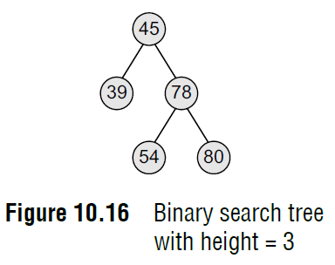
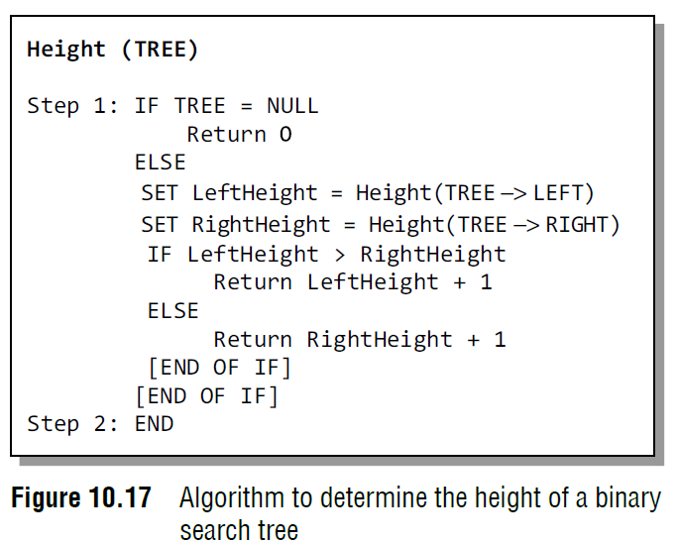
Determining the Height of a Binary Search Tree
In order to determine the height of a binary search tree, we calculate the height of the left sub-tree and the right sub-tree.
Whichever height is greater, 1 is added to it.
Look at Fig. 10.16. Since the height of the right sub-tree is greater than the height of the left sub-tree, the height of the tree = height (right sub-tree) + 1= 2 + 1 = 3.
Figure 10.17 shows a recursive algorithm that determines the height of a binary search tree.
In Step 1 of the algorithm, we first check if the current node of the TREE = NULL. If the condition is true, then 0 is returned to the calling code.
Otherwise, for every node, we recursively call the algorithm to calculate the height of its left sub-tree as well as its right sub-tree.
The height of the tree at that node is given by adding 1 to the height of the left sub-tree or the height of right sub-tree, whichever is greater.

Slide 21
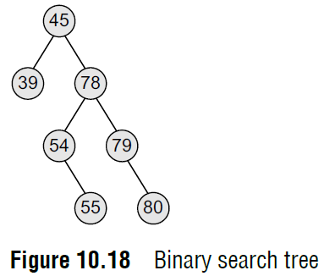
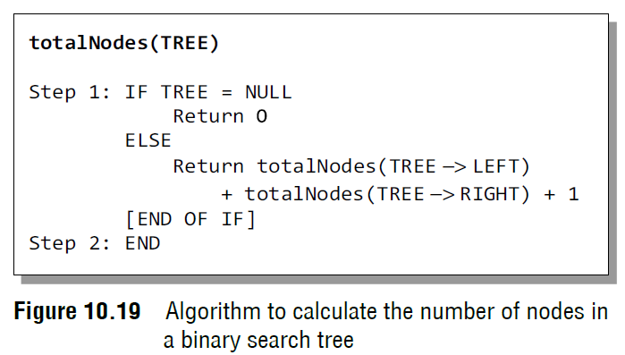
Determining the Number of Nodes
To calculate the total number of elements/nodes in the tree, we count the number of nodes in the left sub-tree and the right sub-tree.
Number of nodes = totalNodes(left sub–tree) + totalNodes(right sub–tree) + 1
Consider the tree given in Fig. 10.18. The total number of nodes in the tree can be calculated as:
Total nodes of left sub–tree = 1
Total nodes of right sub–tree = 5
Total nodes of tree = (1 + 5) + 1
Total nodes of tree = 7
Figure 10.19 shows a recursive algorithm to calculate the number of nodes in a binary search tree. For every node, we recursively call the algorithm on its left sub-tree as well as the right sub-tree. The total number of nodes at a given node is then returned by adding 1 to the number of nodes in its left as well as right sub-tree. However if the tree is empty, that is TREE = NULL, then the number of nodes will be zero.

Slide 22
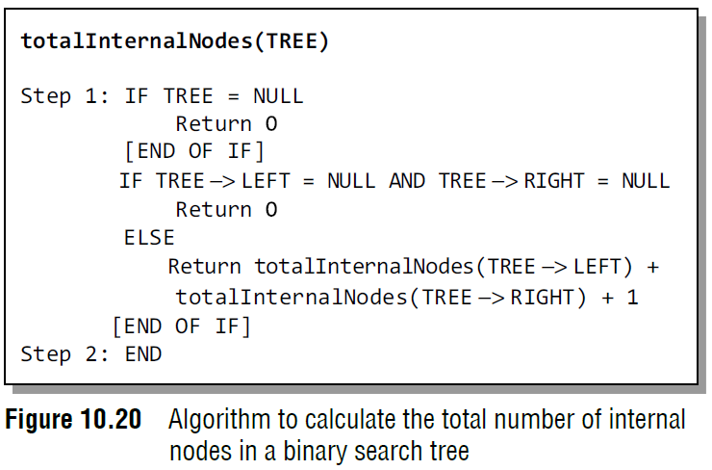
Determining the Number of Internal Nodes
To calculate the total number of internal nodes or non-leaf nodes, we count the number of internal nodes in the left sub-tree and the right sub-tree and add 1 to it
Numberofinternalnodes = totalInternalNodes(left sub–tree)
+ totalInternalNodes(right sub–tree) + 1
The total number of internal nodes in the tree given in Fig. 10.18 can be calculated as:
Total internal nodes of left sub–tree = 0
Total internal nodes of right sub–tree = 3
Total internal nodes of tree = (0 + 3) + 1= 4
Figure 10.20 shows a recursive algorithm to calculate the total number of internal nodes in a binary search tree. For every node, we recursively call the algorithm on its left subtree as well as the right sub-tree. The total number of internal nodes at a given node is then returned by adding internal nodes in its left as well as right sub-tree.
However, if the tree is empty, that is TREE = NULL, then the number of internal nodes will be zero. Also if there is only one node in the tree, then the number of internal nodes will be zero.

Slide 23
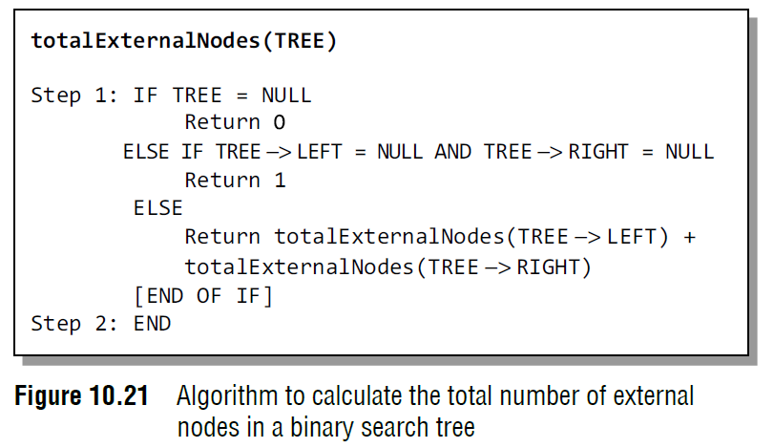
Determining the Number of External Nodes
To calculate the total number of external nodes or leaf nodes, we add the number of external nodes in the left sub-tree and the right sub-tree.
Number of external nodes = totalExternalNodes(left sub–tree) + totalExternalNodes (right sub–tree)
Consider the tree given in Fig. 10.18. The total number of external nodes in the given tree can be calculated as:
Total external nodes of left sub–tree = 1
Total external nodes of right sub–tree = 2
Total external nodes of tree = 1 + 2 = 3
Figure 10.21 shows a recursive algorithm to calculate the total number of external nodes in a binary search tree.
For every node, we recursively call the algorithm on its left sub-tree as well as the right sub-tree. The total number of external nodes at a given node is then returned by adding the external nodes in its left as well as right sub-tree.
However if the tree is empty, that is TREE = NULL, then the number of external nodes will be zero. Also if there is only one node in the tree, then there will be only one external node (that is the root node).

Slide 24
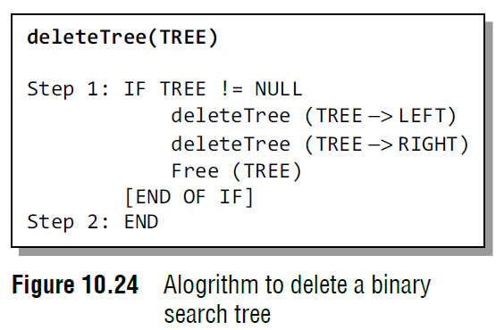
Deleting a Binary Search Tree
To delete/remove an entire binary search tree from the memory, we first delete the elements/nodes in the left sub-tree and then delete the nodes in the right sub-tree.
The algorithm shown in Fig. 10.24 gives a recursive procedure to remove the binary search tree.

Slide 25
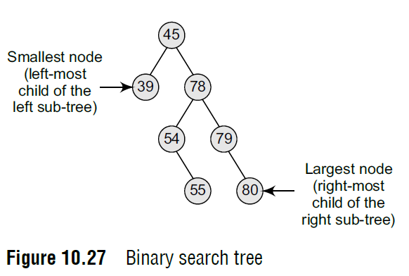
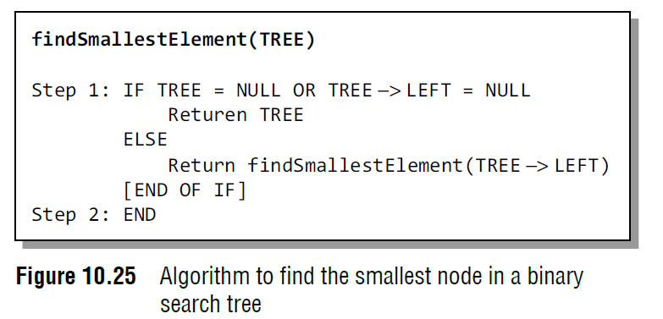
Finding the Smallest Node in a Binary Search Tree
The very basic property of the binary search tree states that the smaller value will occur in the left sub-tree.
If the left sub-tree is NULL, then the value of the root node will be smallest as compared to the nodes in the right sub-tree.
So, to find the node with the smallest value, we find the value of the leftmost node of the left sub-tree.
The recursive algorithm to find the smallest node in a binary search tree is shown in Fig. 10.25.

Slide 26
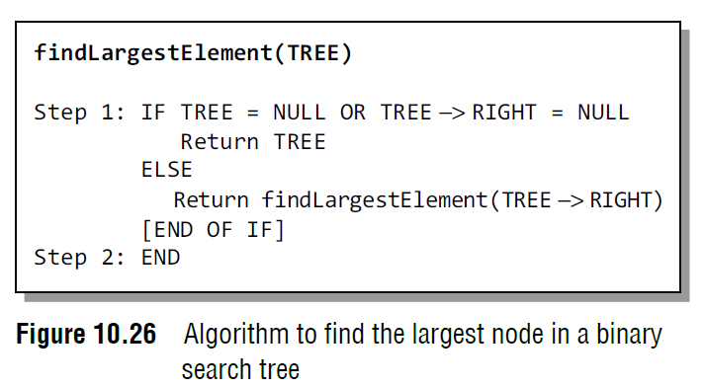
Finding the Largest Node in a Binary Search Tree
To find the node with the largest value, we find the value of the rightmost node of the right subtree.
However, if the right sub-tree is empty, then the root node will be the largest value in the tree.
The recursive algorithm to find the largest node in a binary search tree is shown in Fig. 10.26.

Slide 27
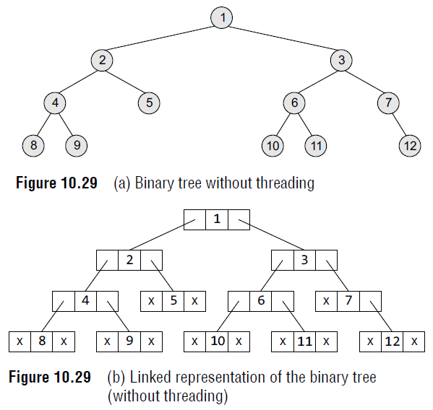
Threaded Binary Trees
A threaded binary tree is the same as that of a binary tree but with a difference in storing the NULL pointers. Consider the linked representation of a binary tree as given in Fig. 10.29.
In the linked representation, a number of nodes contain a NULL pointer, either in their left or right fields or in both.

Slide 28
Threaded Binary Trees
For example, the NULL entries can be replaced to store a pointer to the in-order predecessor or the in-order successor of the node.
These special pointers are called threads and binary trees containing threads are called threaded trees.
In the linked representation of a threaded binary tree, threads will be denoted using arrows.
There are many ways of threading a binary tree and each type may vary according to the way the tree is traversed.
We will discuss in-order traversal of the tree.

Slide 29
Threaded Binary Trees
In one-way threading, a thread will appear either in the right field or the left field of the node. A one-way threaded tree is also called a single-threaded tree.
If the thread appears in the left field, then the left field will be made to point to the in-order predecessor of the node. Such a one-way threaded tree is called a left-threaded binary tree.
On the contrary, if the thread appears in the right field, then it will point to the in-order successor of the node. Such a one-way threaded tree is called a right threaded binary tree.
In a two-way threaded tree, also called a double-threaded tree, threads will appear in both the left and the right field of the node.
While the left field will point to the in-order predecessor of the node, the right field will point to its successor.
A two-way threaded binary tree is also called a fully threaded binary tree.

Slide 30
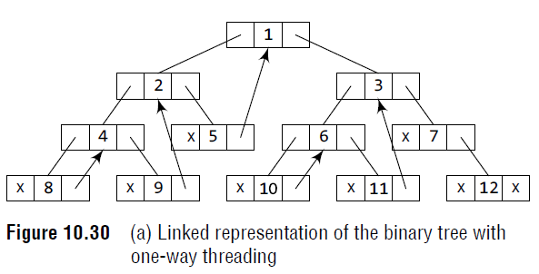
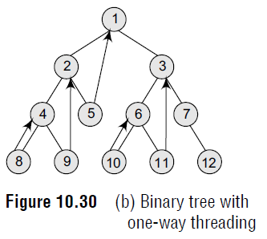
One-way Threading
Figure 10.29 shows a binary tree without threading and its corresponding linked representation.
The in-order traversal of the tree is given as 8, 4, 9, 2, 5, 1, 10, 6, 11, 3, 7, 12
Figure 10.30 shows a binary tree with one-way threading and its corresponding linked representation.
Node 5 contains a NULL pointer in its RIGHT field, so it will be replaced to point to node1, which is its in-order successor.
Similarly, the RIGHT field of node 8 will point to node 4, the RIGHT field of node 9 will point to node 2, the RIGHT field of node 10 will point to node 6, the RIGHT field of node 11 will point to node 3, and the RIGHT field of node 12 will contain NULL because it has no in-order successor.

Slide 31
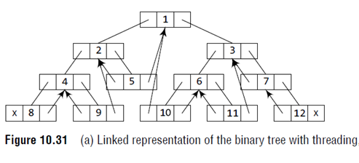
Two-way Threading
The in-order traversal of the tree is given as 8, 4, 9, 2, 5, 1, 10, 6, 11, 3, 7, 12
Figure 10.31 shows a binary tree with two-way threading and its corresponding linked representation.
Node 5 contains a NULL pointer in its LEFT field, so it will be replaced to point to node 2, which is its in-order predecessor.
Similarly, the LEFT field of node 8 will contain NULL because it has no in-order predecessor, the LEFT field of node 7 will point to node 3, the LEFT field of node 9 will point to node 4, the LEFT field of node 10 will point to node 1, the LEFT field of node 11 will contain 6, and the LEFT field of node 12 will point to node 7.

Slide 32
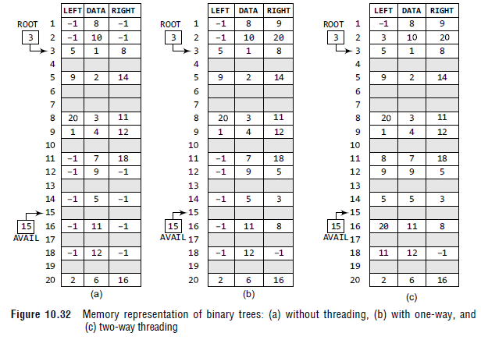
Threaded Binary Trees

Slide 33
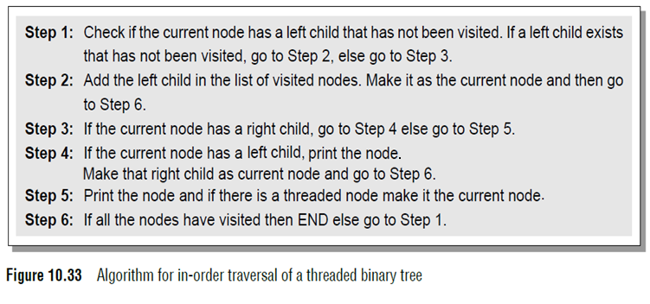
Traversing a Threaded Binary Tree
For every node, visit the left sub-tree first, provided if one exists and has not been visited earlier.
Then the node (root) itself is followed by visiting its right sub-tree (if one exists).
In case there is no right sub-tree, check for the threaded link and make the threaded node the current node in consideration. The algorithm for in-order traversal of a threaded binary tree is given in Fig. 10.33.

Slide 34
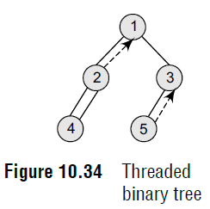
Traversing a Threaded Binary Tree
Let’s consider the threaded binary tree given in Fig. 10.34 and traverse it using the algorithm.
1. Node 1 has a left child i.e., 2 which has not been visited. So, add 2 in the list of visited nodes, make it as the current node.
2. Node 2 has a left child i.e., 4 which has not been visited. So, add 4 in the list of visited nodes, make it as the current node.
3. Node 4 does not have any left or right child, so print 4 and check for its threaded link. It has a threaded link to node 2, so make node 2 the current node.
4. Node 2 has a left child which has already been visited. However, it does not have a right child. Now, print 2 and follow its threaded link to node 1. Make node 1 the current node.
5. Node 1 has a left child that has been already visited. So print 1. Node 1 has a right child 3 which has not yet been visited, so make it the current node.
6. Node 3 has a left child (node 5) which has not been visited, so make it the current node.
7. Node 5 does not have any left or right child. So print 5. However, it does have a threaded link which points to node 3. Make node 3 the current node.
8. Node 3 has a left child which has already been visited. So print 3.
9. Now there are no nodes left, so we end here. The sequence of nodes printed is—4 2 1 5 3.

Slide 35
Advantages of Threaded Binary Tree
It enables linear traversal of elements in the tree.
It enables to find the parent of a given element without explicit use of parent pointers.
Since nodes contain pointers to in-order predecessor and successor, the threaded tree enables forward and backward traversal of the nodes as given by in-order fashion.
Thus, we see the basic difference between a binary tree and a threaded binary tree is that in binary trees a node stores a NULL pointer if it has no child and so there is no way to traverse back.

